Slide 1
WAP Security
Submitted by: Evaniairihun Sohphoh & Lucy Kurbah
Group I

Slide 2
Contents
Introduction
Overview Of WAP
Overview Of WTLS
WTLS and TLS
WTLS Architecture
Handshake Procedure
How Security Is Achieved
Security Flaws, Threats, and Possible Solutions
Encryption Gap in the WAP Gateway
Known Attacks against WTLS
User Authentication or Device Authentication
Conclusion
References

Slide 3
Introduction
Nowadays, more and more people are using cellular phones for online shopping, online banking, stock trading
However, it is known that wireless signals can be easily intercepted by a affordable scanner tuned into the same frequency
So before we start to send sensitive financial data or corporative information through the air, we need a way to secure our communication.
The WAP (Wireless Application Protocol) was proposed in 1997 to meet this need by the WAP Forum formed by Ericsson, Motorola, Nokia, and Phone.com.
WAP is not only a wireless communications protocol but also an application environment that facilitates wireless service deployment for various devices

Slide 4
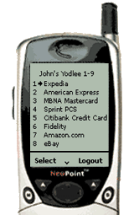
Overview Of WAP
Web Server
Internet
Gateway

Slide 5
WAP Application Architecture
In addition to the web clients, the Internet, and web servers, the WAP application architecture also consists of a wireless network and a WAP gateway.
When a user sends a request from her cell phone, the request is first sent in WML (Wireless Markup Language) or WMLScript format to the WAP gateway
The gateway will then translate the request into a corresponding request in the format of an Internet protocol such as HTTP, and send it along to the web server

Slide 6
The requested file sent from the web server also travels via the WAP gateway which again translates and compresses the file before forwarding it to the client
The WAP gateway acts as a proxy between the client and the server but its existence is transparent to the web server
Gateway
Web Server
Client
Encoded
Request
Request
(URL)
CGI,
Scripts,
Etc.
Encoders
And
Decoders
WAE
User
Agent
Encoded
Response
Response
(Content)
Content

Slide 7
WAP Protocol Stack
WAP is not just one protocol. It actually defines a stack of protocols similar to the Internet ISO OSI model
WAP only has five layers
From the top of stack, there are
WAE (Wireless Application Environment)
WSP (Wireless Session Layer)
WTP (Wireless Transaction Layer),
WTLS (Wireless Transport Layer Security) and
WDP (Wireless Datagram Protocol)
WDP provides the interface between the upper layer and the bearer services such as SMS, CDMA, etc
WTLS is the layer that provides most of the security functionalities for WAP applications
These functionalities include client-server mutual authentication, privacy, data integrity, and non-repudiation

Slide 8
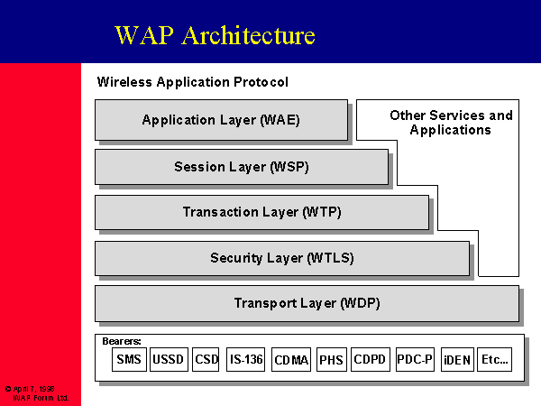
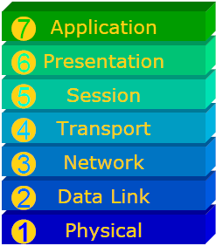

Slide 9
Overview of WTLS WTLS and TLS
The design of WTLS is based upon TLS (Transport Layer Security) that is in turn built upon SSL (Secure Socket Layer)
Similar to TLS, WTLS requires the client and the server negotiate and agree on a set of security parameters during the handshake before the communicate channel can be established
Once handshake succeeds, the client and the server can exchange information using the secrets known to both ends of the channel.
WTLS is vulnerable to a variety of known attacks such as plaintext recovery attacks and datagram truncation attacks

Slide 10
WTLS Architecture
WTLS again can be divided into four specialized protocols
The handshake protocol is by definition responsible for client-server handshake during which the client and the server determine a set of security parameters to be used in the following message exchanges
These parameters contain the bulk encryption algorithm, the MAC algorithm, the compression algorithm, the 20-byte master secret, the 16-byte client random, the 16-byte server random, the time interval of key refresh, and the sequence number mode
The alert protocol specifies the type of alert messages and the ways to handle them.
There are three types of alerts: warning, critical, and fatal.
Alerts can be initiated by either the client or the server whenever an error is detected during the handshake, authentication, decryption, or data integrity verification.
Fatal alerts will obviously lead to the termination of the connection.
The application protocol defines the interface between the transaction layer and WTLS.
The change cipher specific protocol is usually used in the end of the handshake when the client and the server have agreed upon the security parameters.

Slide 11
Handshake Procedure
The clients initiates the handshake by sending a Hello message together with some security settings such as the trusted certificates and supported encryption and MAC algorithms.
Upon receipt of this message, the server sends server hello, server certificate, server key exchange messages
Some required parameter for generating the pre-master secret may not be found in the server certificate. The server key exchange message is to provide this kind of information
If the server needs to authenticate the client, it will also send a certificate request message. Following these messages is the server hello done message.

Slide 12
Once the client receives the server hello done message stating the chosen algorithms, it will sends client certificate message if required
Client key exchange message contains the pre-master secret encrypted by the servers public key.
Then the client sends the finish message together with the message digest of all the previously exchanged information signed by the client to ensure that this sensitive information has not been tampered by any intruders.
After verifying the message digest, the server responds with finish message and cipher change message if everything is fine. Otherwise, the connection will not be established

Slide 13
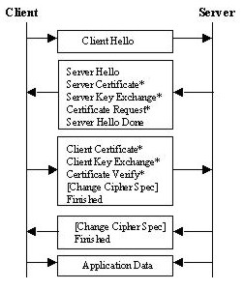
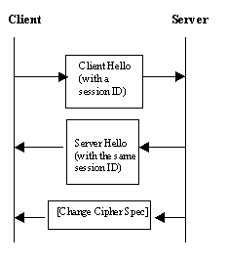
Complete handshake
Resume connection

Slide 14
How Security Is Achieved
Authentication is mainly achieved by the server and client certificates
Key exchange can be achieved with RSA, Diffie-Hellman
The server decides which one actually to use.
To verify data integrity, WTLS supports SHA-1, MD5, and SHA_XOR_40, a rather incompetent algorithm that cannot really protect messages from unauthorized modifications

Slide 15
Security Flaws, Threats, and Possible Solutions
Encryption Gap in the WAP Gateway
The WAP gateway lives between web clients and application servers. It not only relays messages but also works as encoder and decoder
A WAP gateway translates WML and WMLScripts requests into HTTP or other Internet requests and vice versa. In other words, if a message is encrypted by WTLS, the gateway will firstly decrypts it and then re-encrypts with TLS
.There is a white spot between decryption and re-encryption. In fact, when we talk about end-to-end security in WAP applications, the end-to-end channel is actually between the web client and the gateway, rather than between the client and the application server. It is obvious that the gateway will become the attack magnet
To solve this problem the owners of the gateways (usually network carriers) try to execute the entire translation in the memory to avoid critical information from being exposed.

Slide 16
2. Known Attacks against WTLS
WTLS supports DES with only 40-bit keys
For DES, one bit of each byte of the key is used as a parity bit. So we end up with keys with even fewer bits: 5*7 = 35 bits in total. For modern attackers with enough processing power, cracking a cipher with such a small key is not very hard.
WTLS supports a MAC algorithm called SHA_XOR_40. This algorithm is designed for some devices with very limited CPU resources
What it does is first to pad the message with zeros to the end, then divide the padded message into 5-byte blocks. In the end, all the blocks are xord together to generate the digest. However, one can easily flip a bit in one block and the corresponding bit in the digest. The receiver will have no way to tell that the message has been modified!
WTLS is also shown to be weak on avoiding viruses, worms, and Trojan horses

Slide 17
3. User Authentication or Device Authentication
Another cause of security problem lies in the mobile nature of the wireless devices
If a user stores his passwords and credentials locally and someone else gets hold of the cell phone, WAP applications will not detect the difference.
Therefore, in order to draw a clear line between user authentication and device authentication, people came up with the idea of using WIM (Wireless Identification Module).
WIM can be implemented in a smart card or a SIM card. As long as the user can get used to keeping the card and the phone apart, the user authentication can be achieved.
Also the card can have dedicated memory and computing power for carrying out authentication.
However, this solution will require a change of behavior which we have seen how hard it is to accomplish by taking the example of password usage

Slide 18
Conclusion
WAP is a protocol aiming to provide a standardized wireless application environment to various services
Its security services such as mutual authentication, data privacy, data integrity, and non-repudiation should be able to meet users requirements at most of the times. However, due to the resource limitations and exportation regulations, WAP still have security loopholes known to the public. In order to solve these issues, the WAP Forum keeps working on the improvements to the WAP specifications. Some companies are trying to provide solutions without using the WAP gateway
as the development of wireless communications accelerates, WAP will draw more attention from both consumers and application developers

Slide 19
References
Saarinen, Markku-Juhani, “Attacks against the WAP WTLS Protocol”, 9/221999 [Referred on 3/24/2004], < http://www.jyu.fi/~mjos/wtls.pdf>

